Slide 1
Chapter 3
Discrete Random Variables
and
Their Probability Distributions
1

Slide 2
OBJECTIVES
Random Variable
Expected Value of a Discrete Random Variable
Standard Deviation of a Discrete Random Variable
Properties of Expected Values and Variances

Slide 3
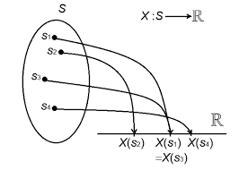
Random Variable
A variable is a quantity whose value changes.
A variable whose value is based on the outcome of a random event is called a random variable.
A random variable is a real-valued function defined over a sample space.
3

Slide 4
Random Variables
RV
Discrete
Continuous
4

Slide 5
Discrete Random Variable
A discrete random variable is one which may take on only a countable number of distinct values such as 0,1,2,3,4,...
Discrete random variables are usually counts.
If a random variable can take only a finite number of distinct values, then it must be discrete.

Slide 6
Discrete Random Variable
Examples :
The number of children in a family.
The Friday night attendance at a cinema.
The number of patients in a doctor's surgery.
The number of defective light bulbs in a box of ten.

Slide 7
Probability Distribution of Discrete RV
The probability distribution of a discrete random variable is a list of probabilities associated with each of its possible values.
It is also sometimes called the probability function or the probability mass function (pmf).

Slide 8
Example
Flip a coin two times. Let X be the random variable representing how many times heads appears in your two flips.
Sol:
S = {HH, HT, TH, TT}
X = # of heads in two flips
That is X = 0, 1, 2
X | 0 | 1 | 2
P(X) | 0.25 | 0.5 | 0.25

Slide 9
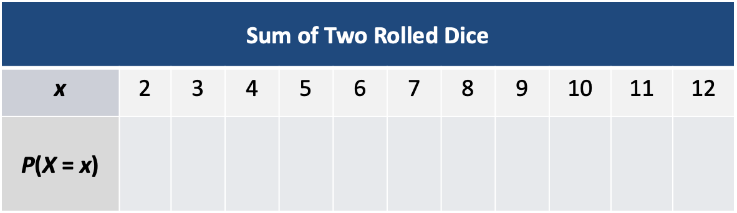
Example
Find the probability distribution of X, the sum of two rolled dice.
Sol:

Slide 10
Probability Distribution of Discrete RV
Suppose a random variable X may take k different values, with the probability that X = x_{i} defined to be
P( X = x_{i} ) = p_{i}
The probabilities p_{i} must satisfy the following:
1: 0 p_{i} 1 for each i.
2: p₁ + p₂ + ... + p_{k} = 1.

Slide 11
Expected Value of a RV
A predicted or anticipated value of a variable.
It is written as E(X) or

Slide 12
Expected Value of a Discrete RV
For a discrete random variable it is calculated as the sum of all possible values each multiplied by the probability of its occurrence.
12
Notes:
QTM1310/ Sharpe
12

Slide 13
Discrete Variable Example
The probability model for a particular life insurance policy is shown. Find the expected annual payout on a policy.
13
Notes:
QTM1310/ Sharpe
13

Slide 14
Discrete Variable Example (cont’)
We expect that the insurance company will pay out $200 per policy per year.
14
Notes:
QTM1310/ Sharpe
14

Slide 15
The Law of the Unconscious Statistician
Suppose X is a discrete random variable and g is a function from the real numbers into the real numbers.
Then Y = g(X) is another discrete random variable
The expected value of Y = g(X) can be calculated using the following result:

Slide 16
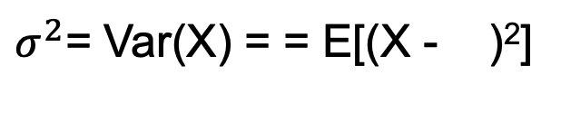
Standard Deviation of a Discrete RV
Variance of a random variable:
$σ^{2}$= Var(X) = = E[(X - )²]
For Discrete RV:
Var(X) =
16
Notes:
QTM1310/ Sharpe
16

Slide 17
Prove the following for a Discrete RV:
V(X) = E[(X − µ)²] = E(X²) − E(X)²

Slide 18
Discrete Variable Example
The probability model for a particular life insurance policy is shown. Find the standard deviation of the annual payout.
18
Notes:
QTM1310/ Sharpe
18

Slide 19
Discrete Variable Example (cont’)
19
Notes:
QTM1310/ Sharpe
19

Slide 20
Properties of Expected Values and
Variances
Adding a constant c to X:
Multiplying X by a constant a:
20
Notes:
QTM1310/ Sharpe
20

Slide 21
Example
The expected annual payout per insurance policy is $200 and the variance is $14,960,000.
If the payout amounts are doubled, what are the new expected value and variance?
21
Notes:
QTM1310/ Sharpe
21

